Slide 1

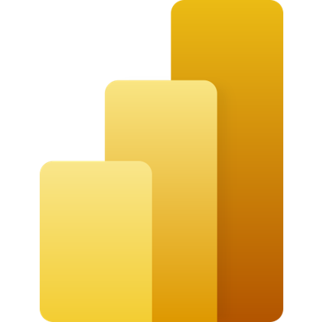
Power BI
mintesnot

Slide 2

What is Business Intelligence?
Power BI
Power BI Architecture
Visualizations
Common Charts
Uncommon Charts
Filters
Slicers
Getting Data in Power BI
Publish
Power BI Workspace

Slide 3
What is Business Intelligence?
Definition: Business Intelligence (BI) refers to technologies, practices, and tools used to analyze & present business data.
Primary Goal: To support better business decision-making by providing actionable insights derived from data analysis.
Core Benefits:
Informed decision-making based on data-driven insights.
Improved efficiency by streaming data management.
Increased revenue through better sales forecasting.

Slide 4
Key components of BI
BI is built on five foundational pillars:
Data Collection: Gathering data from various sources like databases & spreadsheets.
Data Integration: Combining different data sources into a single, cohesive dataset.
Data Analysis: Using statistical methodologies to uncover trends & patterns.
Reporting: Creating dashboards & reports to make insights understandable.
Data Visualization: Utilizing graphical representations to communicate insights effectively.

Slide 5










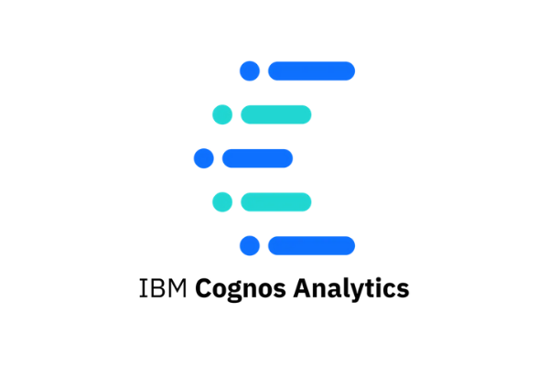

BI Tools

Slide 6
What is Power BI?
Power BI is a powerful business intelligence tool developed by Microsoft.
It is used to analyze and visualize data, allowing users to gain insights from their data and make informed decisions.
Power BI is a versatile tool that can help organizations transform their data into actionable insights, drive better decision-making, and achieve their business goals.
Power BI’s user interface is intuitive for users familiar with Excel, and its deep integration with other Microsoft products makes it a versatile self-service tool that requires little upfront training.
It provides nontechnical business users with tools for aggregating, analyzing, visualizing and sharing data.

Slide 7




…
Transform data into
stunning visuals & share
them with colleagues on
any device.
Visually explore and analyze
data on-premises and in the
cloud all in one view.
Collaborate on & share
customized dashboards &
Interactive reports.
Scale across your organization
with built-in governance and
security.

Slide 8
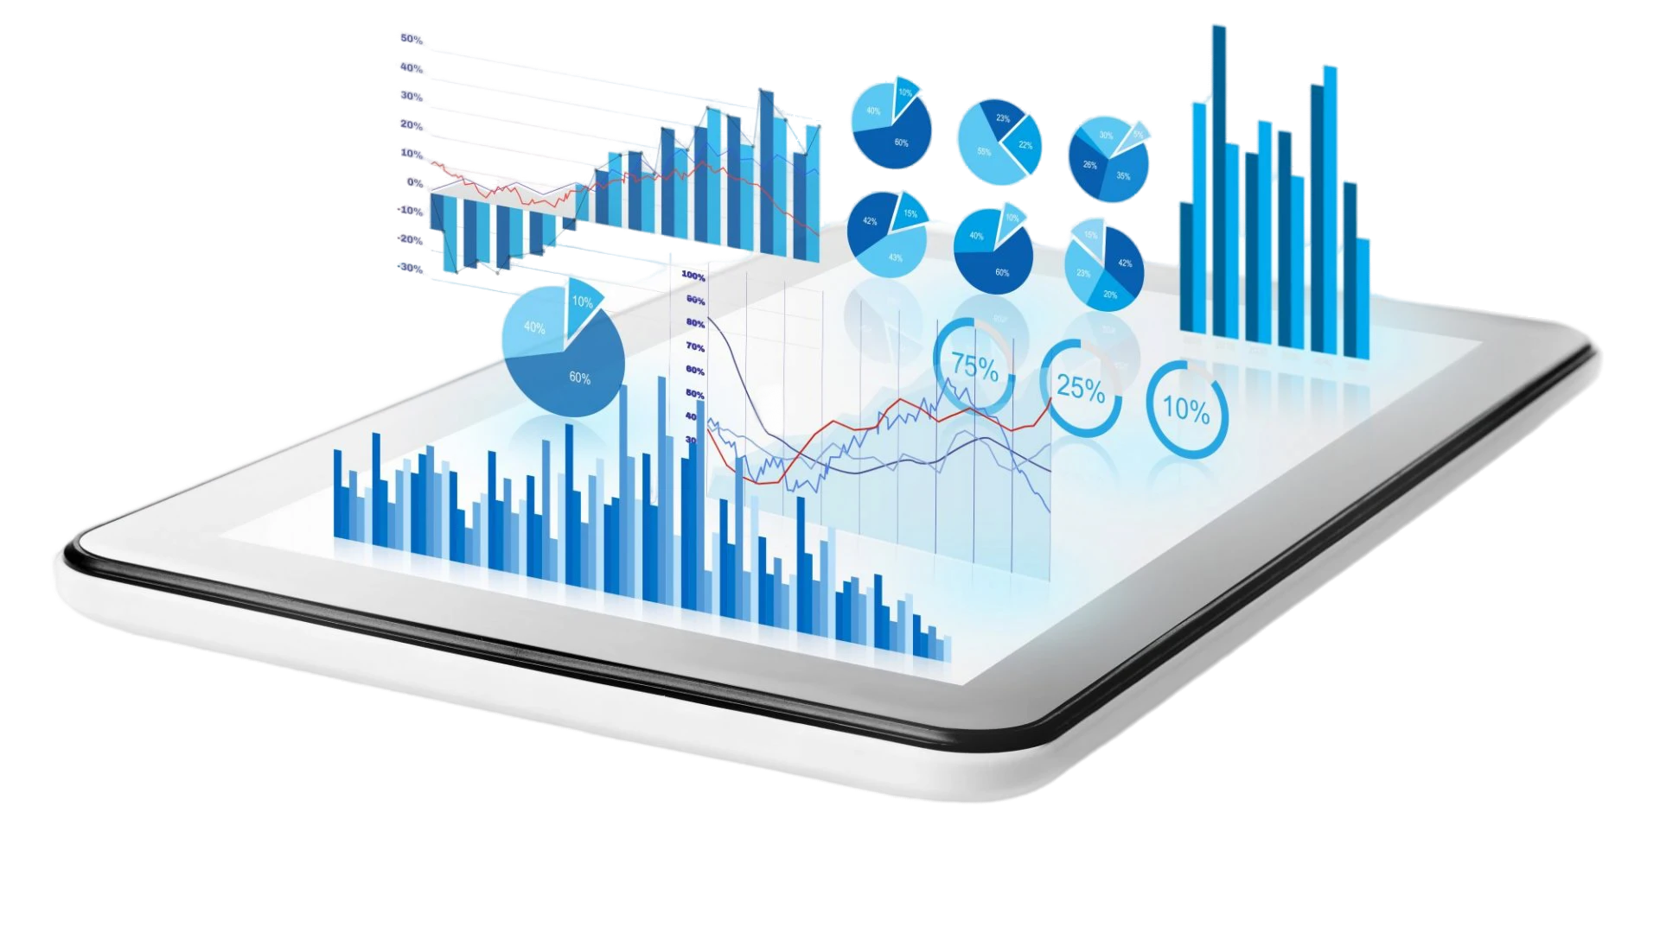
Key Features of Power BI
Data Connectivity
Data Transformation
Data Modeling
Data Visualization
Dashboards
Collaboration & Sharing

Slide 9





How Power BI fit together?
Data Discovery
Data Extraction
Transforms
Data Modeling
Relationships
Calculations
Data Visualization
Visualizations
Filters
Mobile Power BI
Anytime
Anywhere
Power BI Service
Share Results
Data Refresh

Slide 10

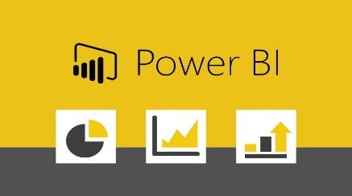


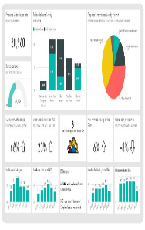
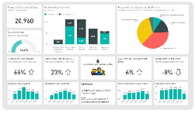

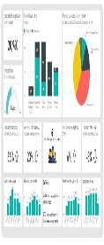
Elements of Power BI Services
Power BI Desktop:
- It resides on the local system and used to build and publish reports.
Power BI Web Service:
- It resides on Web as a form of website & used to build reports, make dashboards & share reports & dashboard with other users.
Power BI Mobile App:
- It is an app version of Power BI which is used to view and share the reports and Dashboards.

Slide 11
Power BI Desktop Vs Power BI Service
Features | Power BI Desktop | Power BI Service
Installation | Requires installation | Cloud-based, accessed via web browser
Data preparation | Advanced capabilities | Focused on visualizing & sharing data
Report creation | Granular control | Simpler authoring experience, still allows for customization
Collaboration | Designed for individual | Allows sharing and collaboration on reports and dashboards
Data refresh | Requires manual refresh | Automatic data refresh

Slide 12


…
Features | Power BI Desktop | Power BI Service
Connecting to multiple data sources
Data Transformation using Query Editor
Data Modeling
Creating Calculated Columns & Measures
Creating Visuals & Reports
Creating & Sharing Dashboard
Creating & managing Workspace Apps
Sharing Reports

Slide 13









Power BI Architecture
Power BI Services
CONNECT
ACCESS
Data Sources
Power BI Gateways
PUBLISH
Power Desktop

Slide 14

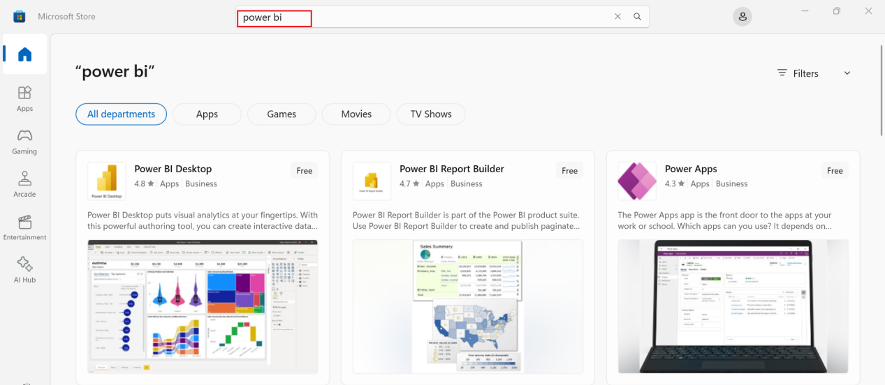
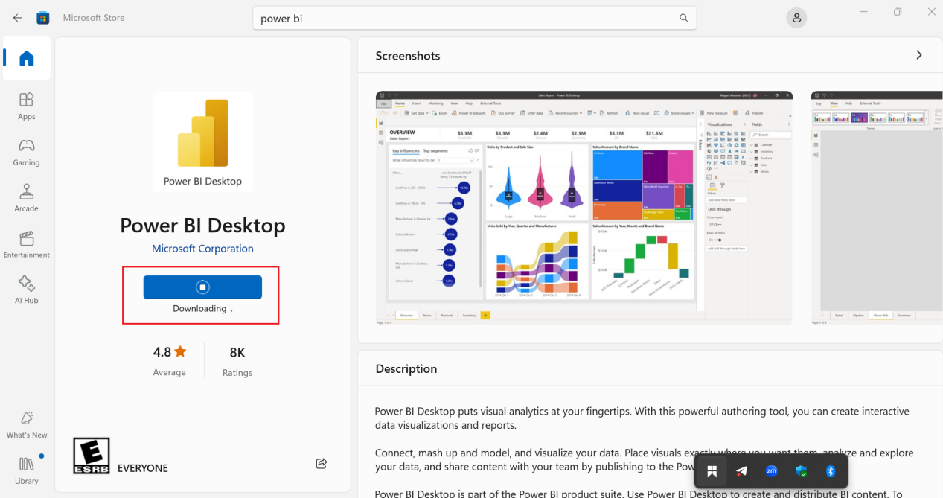

Setup Power BI Desktop
Power BI Desktop, the primary application for creating and modeling reports, is strictly Windows-only.
Start by opening up your Microsoft Store.
Search for Power BI.
Click ‘Free’.

Slide 15

Walk-through Power BI GUI
Ribbon – The top ribbon contains most of the controls and options needed for building the report.
Views – This is made up of the report view, the data view, and the model view.
Canvas – This is the main design area where visualizations & other elements are added.
Page Selector – For navigation to other pages in the report.
Filters – Fields can be added here to filter the data.
Visualizations – This contains the list of available visualizations.
Fields – This section contains the tables & fields that are available in the data model.

Slide 16
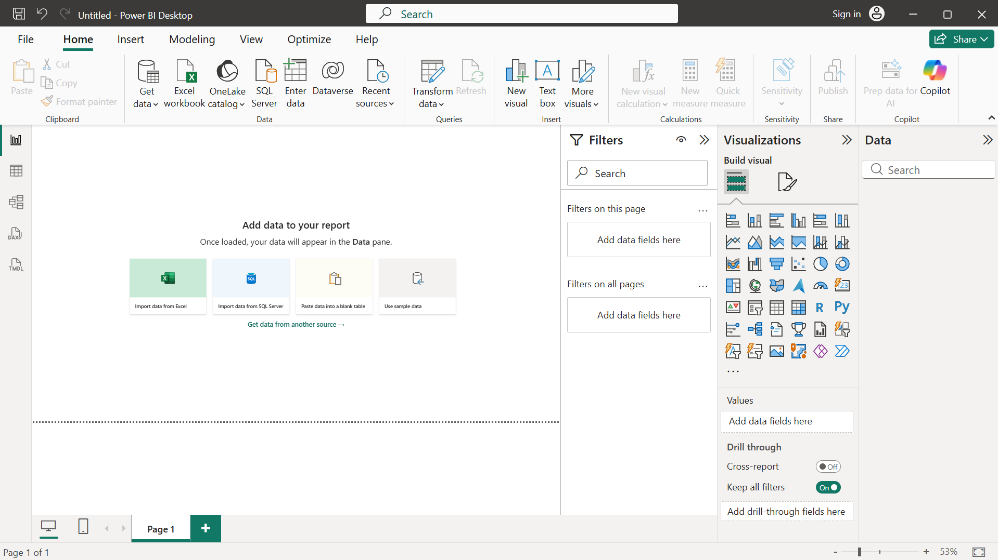
…
Ribbon
Fields
Views
Filters
Canvas
Visualizations
Page Selector

Slide 17
Views in Power BI Desktop
Report View – You can use queries that you create to build compelling visualizations, arranged as you want then to appear, and with multiple pages, that you can share with others.
Data View – See the data in your report in data model format, where you can add measures, create new columns, & manage relationships.
Model View – Get a graphical representation of the relationships that are established in your data model & manage or modify them as needed.

Slide 18
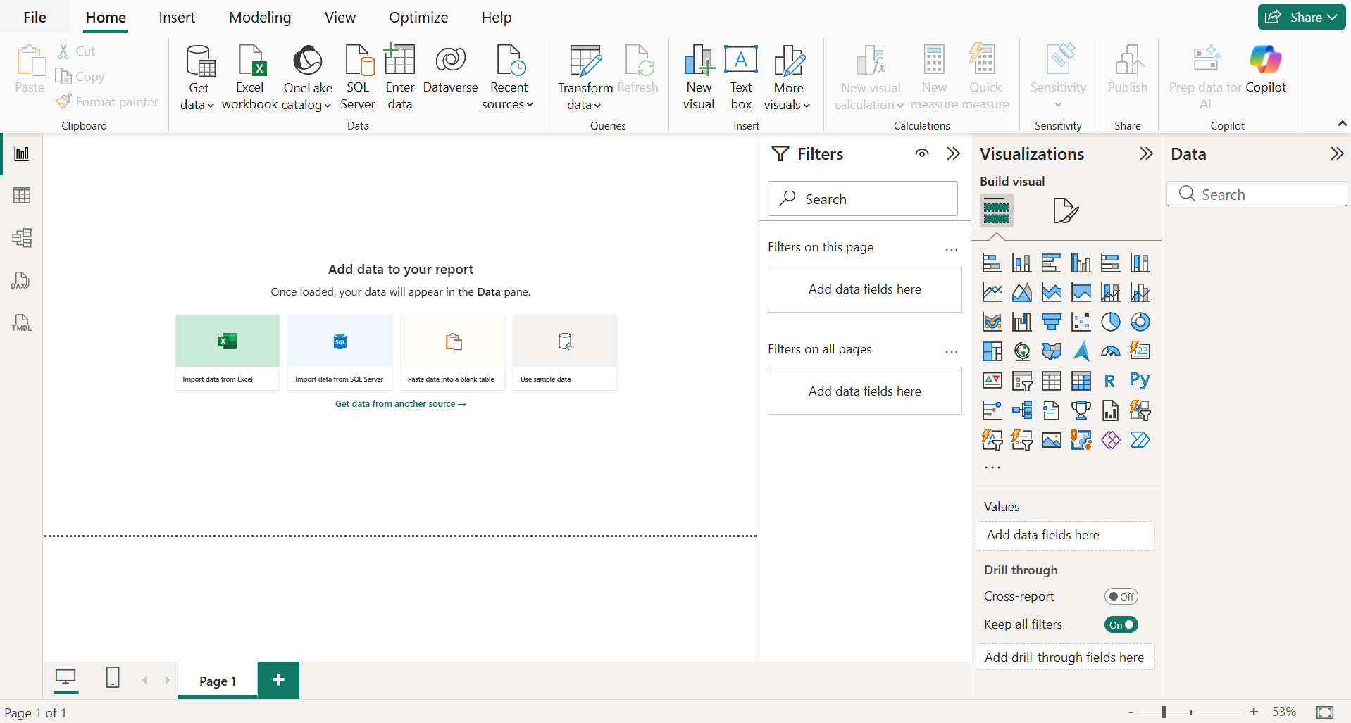
…
Report View
Data View
Model View

Slide 19


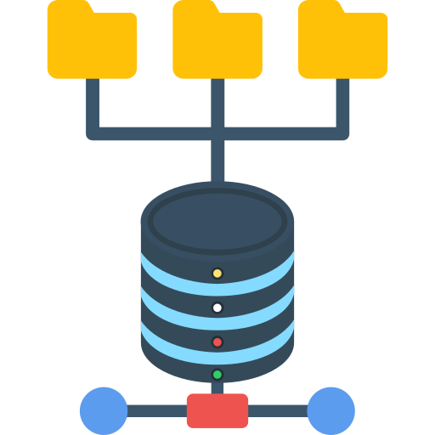



Power BI Contents
Dashboards: Provide high-level overview of key metrics and KPIs. Made up of tiles.
Reports: Interactive and dynamic presentations of data.
Data Sources: Connect to various data sources for analysis
Data Modeling: Create relationships and structures for analysis.
Power Query: Import, clean, and transform data.
Query Editor: Transform and clean data before analysis.

Slide 20



…
Visualizations: Represent data with charts, graphs, and more.
Power Pivot: Build complex data models with DAX.
Apps: Combines related dashboards and reports, all in one place.

Slide 21
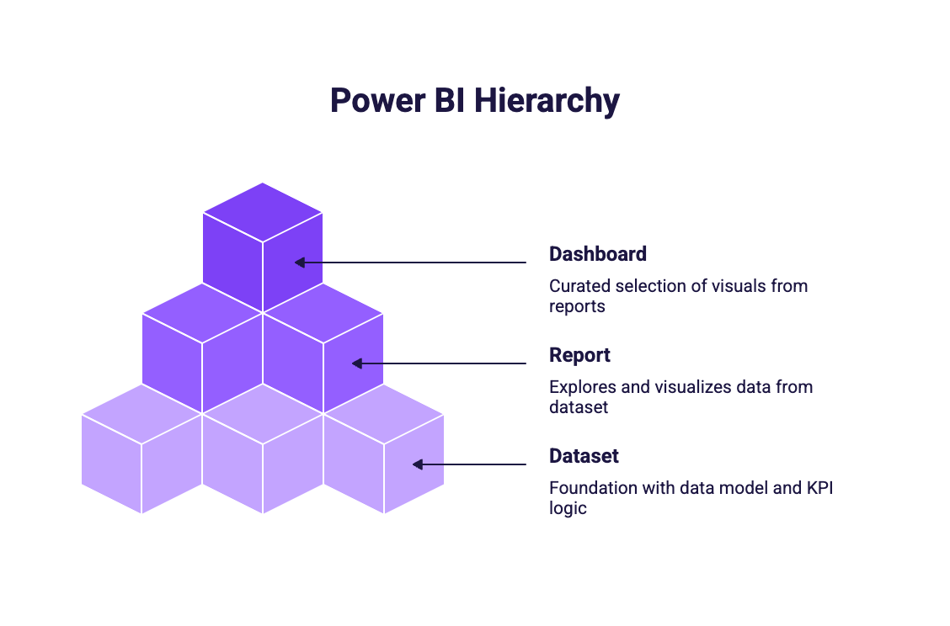
Dashboard, report, and dataset
A dataset is the foundation. It contains the data model, relationships, and KPI logic.
A report sits on top of a dataset and is used to explore, analyze, and visualize the data.
A dashboard sits on top of one or more reports and surfaces a curated selection of visuals.

Slide 22
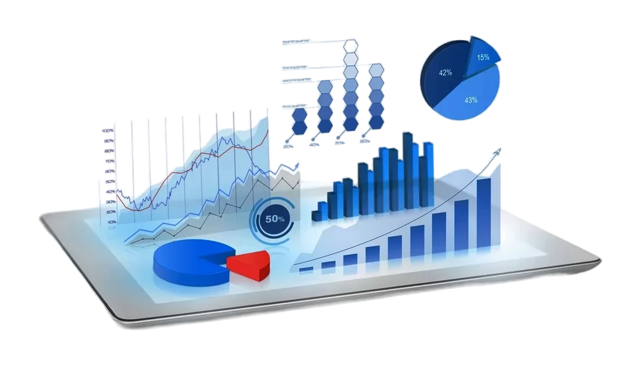
What is Visualization in Power BI?
Visualization in Power BI refers to the graphical representation of data through various types of charts, graphs, and other visual elements.
The primary goal of visualization is to provide a clear and intuitive way to understand complex data.
Enables users to identify trends, patterns, and insights quickly.

Slide 23
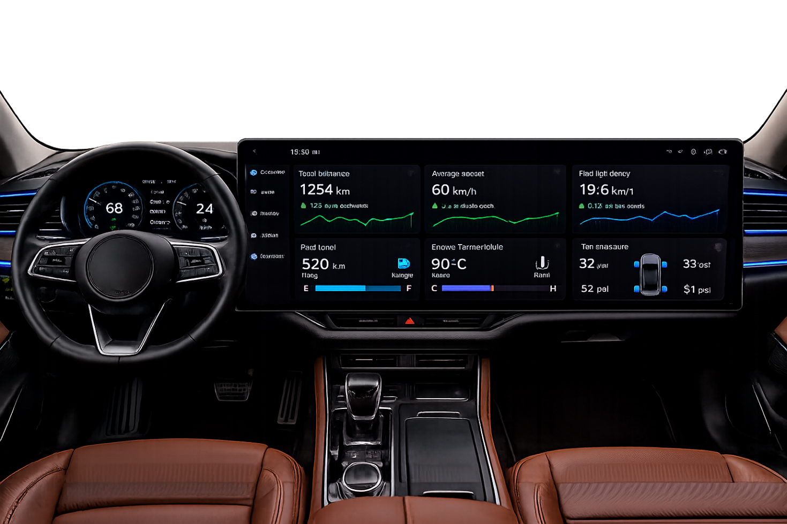
Benefits of Visualization in Power BI
Enhanced Understanding: Visuals make complex data more accessible & understandable.
Quick Insights: Users can quickly grasp key metrics and performance indicators at a glance.
Real-Time Monitoring (Dashboard): Act like a dashboard in a car, providing real-time updates on key metrics.

Slide 24
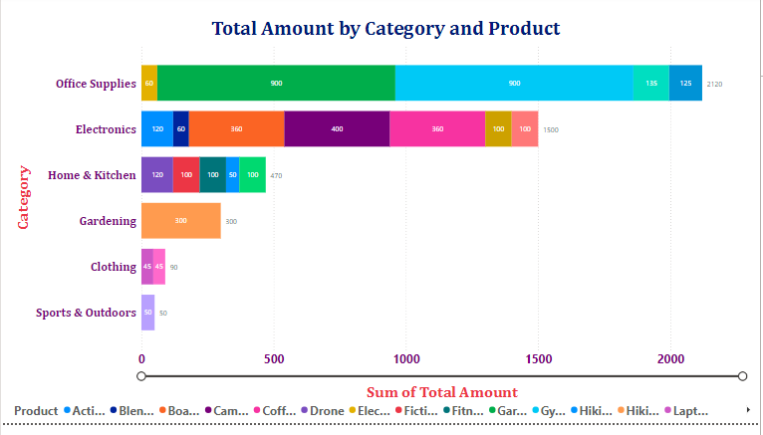
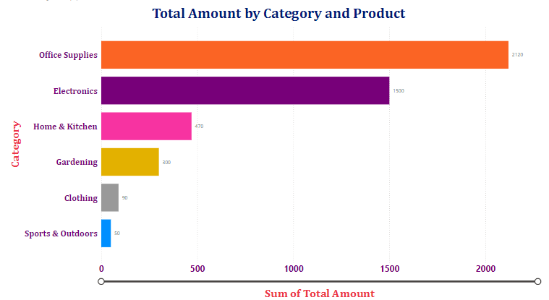
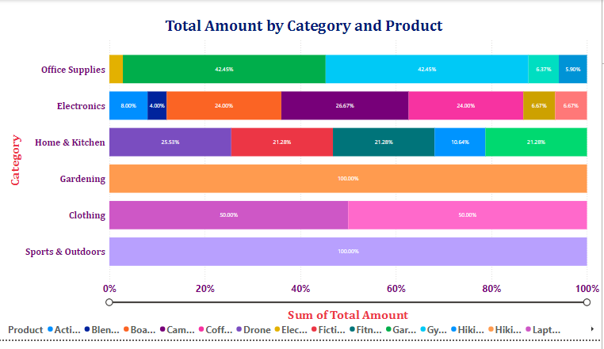
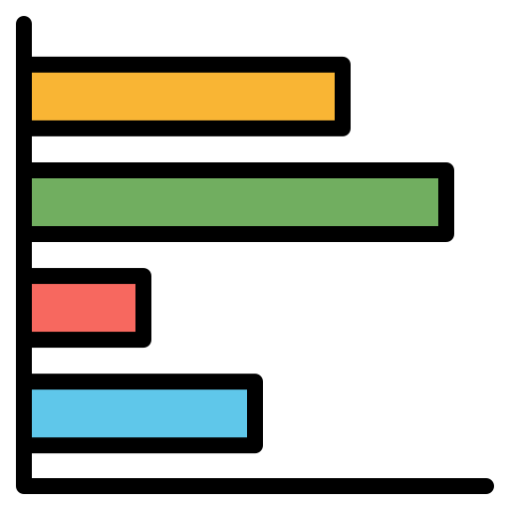
Bar Charts
A Bar chart displays data using horizontal bars.
Length of the bar represents the value.
Categories are listed on the vertical axis.
Three types: Clustered, Stacked & 100% Stacked.
Use Cases:
Compare many categories easily.
Display long category names clearly.
Rank data (highest to lowest).
Best for large data sets & Categorical comparisons.
Stacked
Clustered
100% Stacked

Slide 25
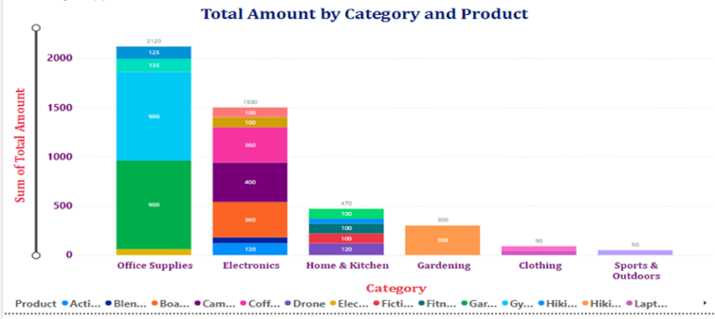
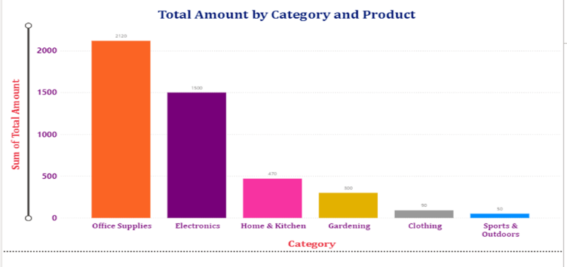
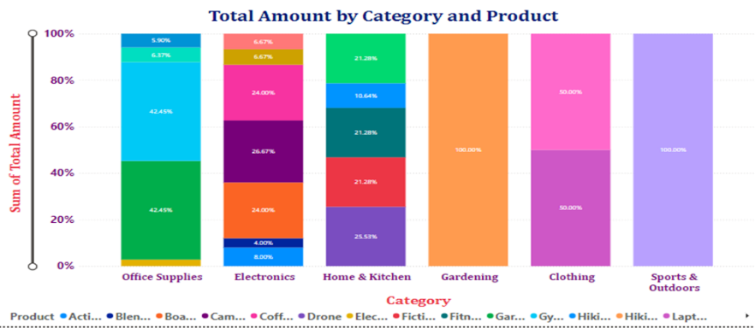

Column Charts
A Column chart displays data using vertical bars.
Each column represents a category.
The height of the column shows the value.
Three types: Clustered, Stacked & 100% Stacked.
Use Cases:
Compare values across categories.
Show changes over time (e.g., monthly sales).
Highlight trends clearly.
Best for time-based data, small to medium number of categories.
Stacked
Clustered
100% Stacked

Slide 26
Column Chart Vs Bar Chart
Feature | Column Chart | Bar Chart
Orientation | Vertical | Horizontal
Best Use | Time trends | Category comparison
Space Usage | Needs more width | Needs more height
Labels | Short labels | Long labels

Slide 27
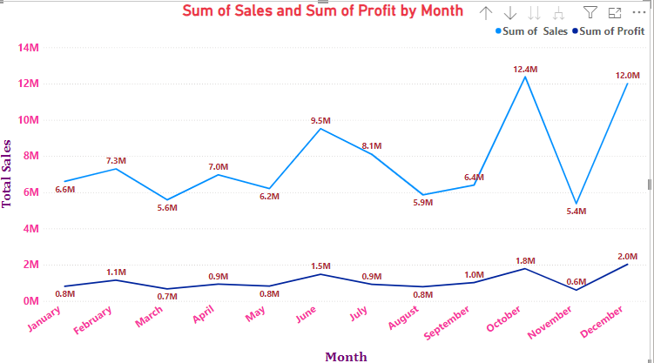
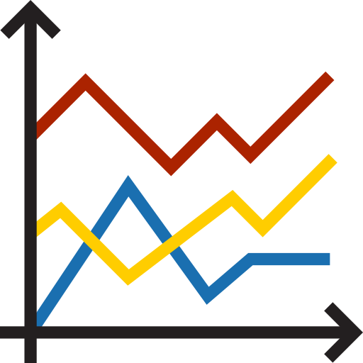
Line Charts
Line Charts are used to display data trends over time.
Data points are connected by a continuous line.
Shows information as a series of data points.
Typically used for time-series data.
Use Cases:
Shows trends over time.
Track performance (sales, revenue, growth).
Compare multiple variables.
Identify patterns & seasonality.
Best for continuous data, time-based analysis.

Slide 28
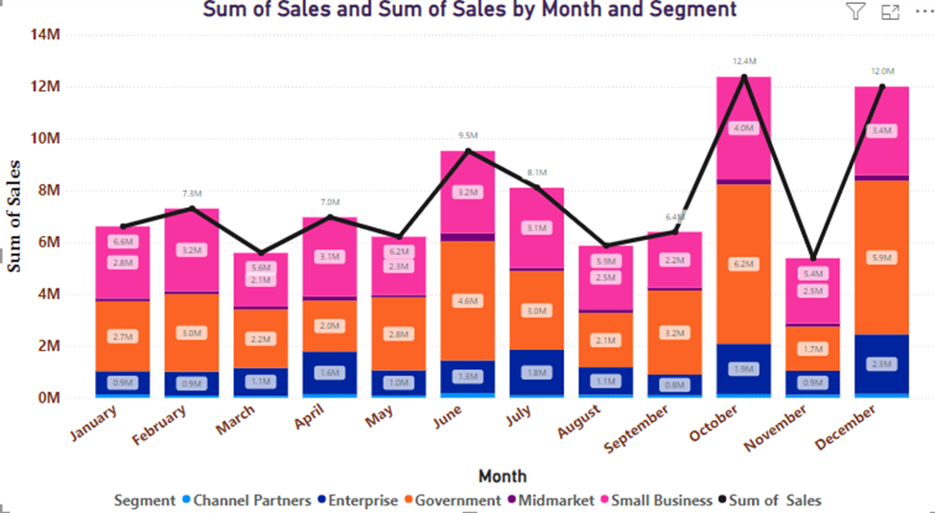
Line & Stacked Column Charts
Line & Stacked Column Chart combines line chart & a stacked column chart.
Allows to analyze trends over time while also observing the composition of different categories.
Use Cases:
Combines multiple insights in one chart
Saves dashboard space.
Shows relationships between metrics.
Compare total vs breakdown.
Show trend + composition together.
Analyze performance across categories over time.

Slide 29
… Comparison with Other Charts
Chart Type | Purpose
Column Chart | Simple Comparison
Line Chart | Trend over time
Stacked Column Chart | Composition
Line & Stacked Column | Trend + Composition together

Slide 30
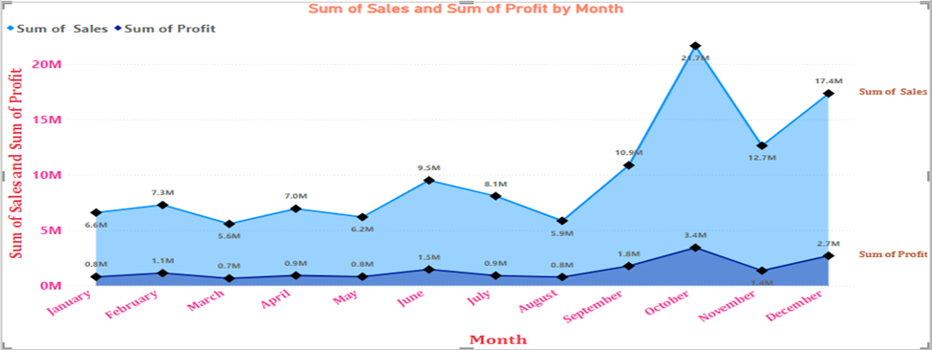

Area Charts
Area Charts are like line charts but with the area filled below the line.
Used to show trends over time along with magnitude. (Highlights trend & quantity).
Helps emphasize the volume of data.
Use Cases:
Show trends over time.
Display cumulative totals.
Compare multiple data series.
Emphasize the magnitude of values.
Best for time-based data, showing contribution to total.

Slide 31
Area Chart Vs Line Chart
Feature | Area Chart | Line Chart
Fill | Colored Area | No Fill
Focus | Trend + Volume | Trend only
Best Use | Cumulative data | Precise trends
Visual Impact | More attractive | Simpler

Slide 32
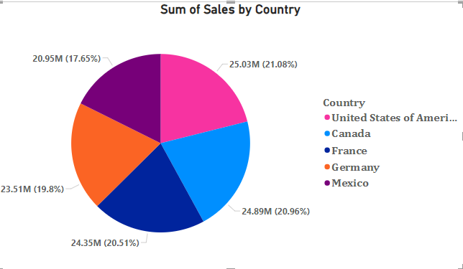

Pie Chart
Pie Chart is a circular chart divided into slices.
Each slice represents a proportion of the total. (Total equals 100%).
Use Cases:
Show percentage distribution.
Compare parts of a whole.
Highlight dominant categories.
Best for Small number of categories (5-6 max & Simple datasets).

Slide 33
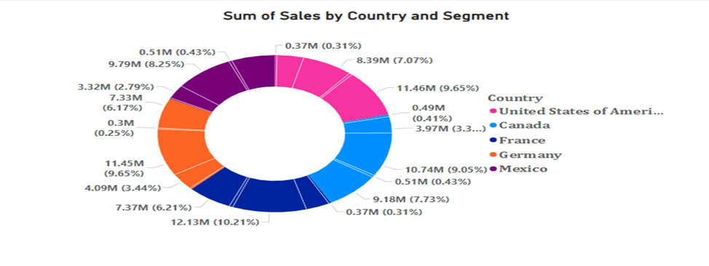

Donut Chart
Donut Chart is like pie chart but with a hole in the center.
Displays proportions in a circular format.
Center space can show additional information.
Use Cases:
Show proportion of categories.
Display summary values in the center.
Improve visual design in dashboards.
Best for Dashboard visuals, Highlighting key metrics.

Slide 34
Pie Chart Vs Donut Chart
Feature | Pie Chart | Donut Chart
Shape | Full Circle | Circle with hold
Center Space | Not available | Available
Best Use | Cumulative data | Precise trends
Visual Impact | More attractive | Simpler

Slide 35
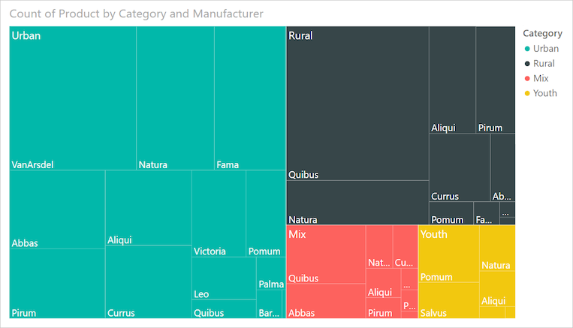

Tree Map
Tree Map displays data as nested rectangles.
Each rectangle represents a category.
Size of the rectangle shows the value.
Use Cases:
Show hierarchical data.
Display many categories at one & efficient use of space.
Compare proportions within categories.
Identify largest and smallest contributors.
Best for Part-to-whole relationships, large datasets with hierarchy.

Slide 36
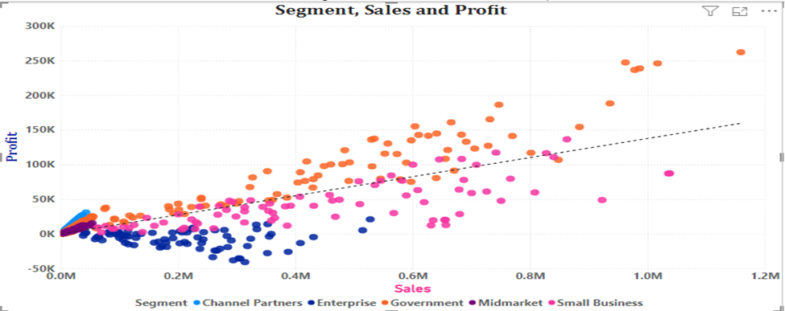
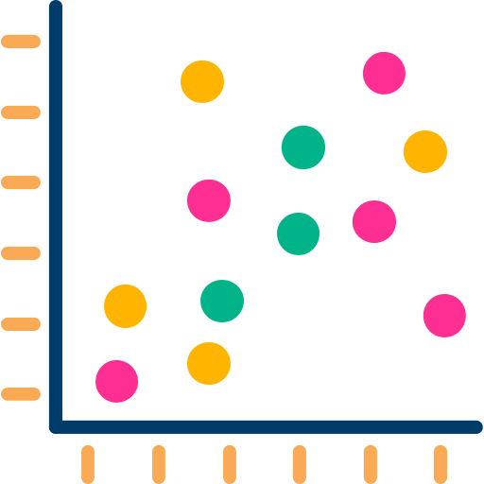
Scatter Plot
Scatter Plot shows data as points on a graph.
Used to display relationship between two variables.
Each point represents a data record.
Use Cases:
Identity relationships or correlations.
Detect patterns and trends.
Spot outliers.
Supports multiple variables.
Helps in predictive analysis.
Best for Numerical data, Statistical Analysis.

Slide 37
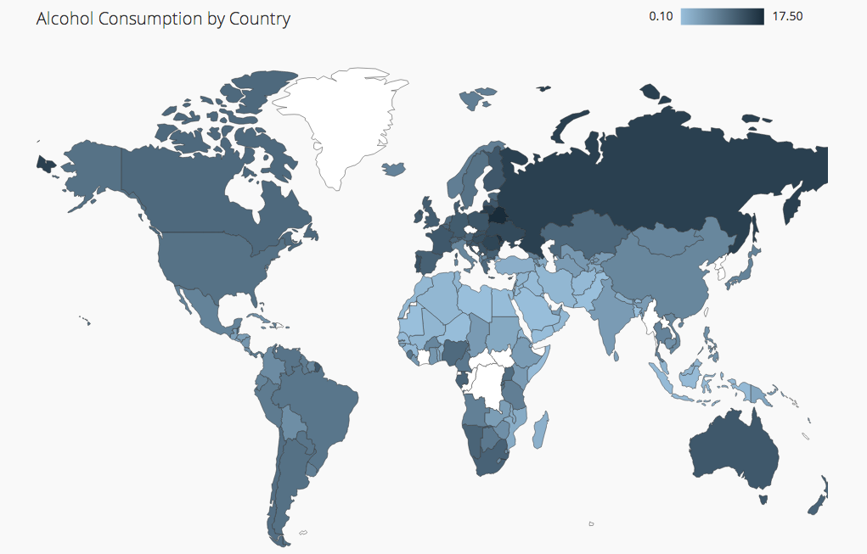

Map Charts
Map Charts display data based on geographic locations.
Helps users understand spatial patterns & trends.
Widely used in business, logistics, and analytics.
It is a visual representation of data on a map based on Country, City, Region, Latitude & Longitude.
Use Cases:
Analyze geographic trends.
Track regional performance.
Identify high & low-performing areas.
Support decision-making based on locations.

Slide 38
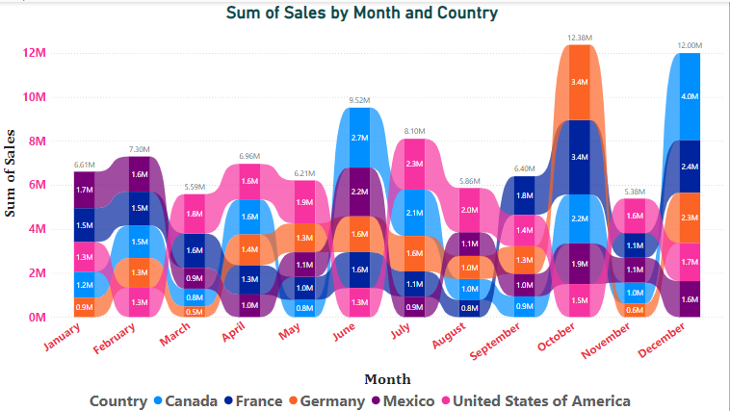
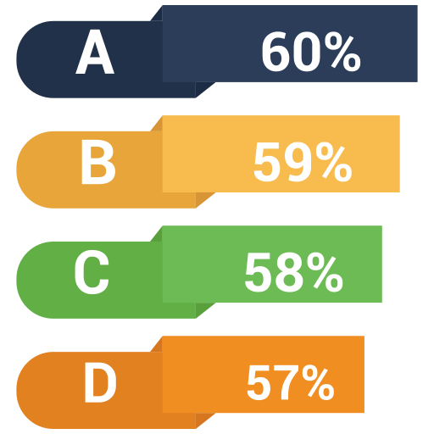
Ribbon Chart
A Ribbon Chart displays categories as ribbons across time.
The position of each ribbon shows its rank.
The width represents the value.
Use Cases:
Track ranking changes over time.
Compare performance between categories.
Visualize competition dynamics.
Best for market share analysis, product performance comparison, sales ranking.

Slide 39
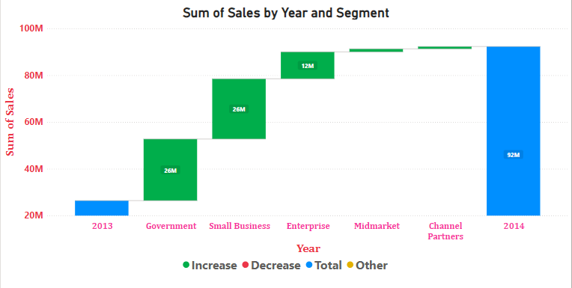

Waterfall Chart
A Waterfall Chart show how a value changes step-by-step.
Useful for understanding positive & negative combinations.
Common in financial & business analysis.
Use Cases:
Analyze financial statements.
Break down profit & loss.
Track changes in metrics over time.
Understand contributions of different factors.
Best for financial analysis, step-by-step value tracking.

Slide 40
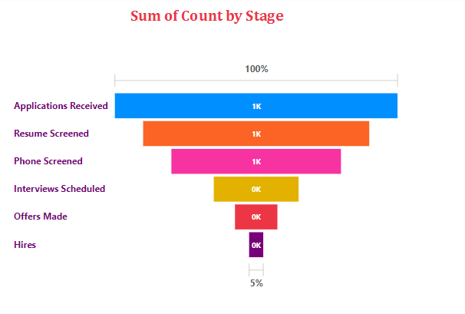
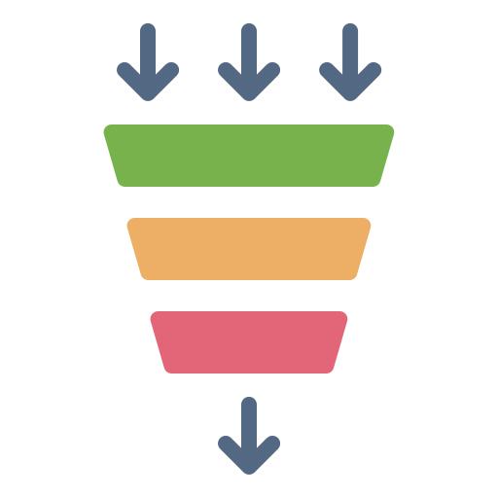
Funnel Chart
A Funnel Chart represent stages in a process.
Show how data flows from one stage to another.
Commonly used in sales & marketing analysis.
Displays values across sequential stages.
Use Cases:
Analyze conversion rates.
Identify drop-offs in processes.
Track performance across stages.
Best for sales pipelines, recruitment processes, website conversion analysis.

Slide 41
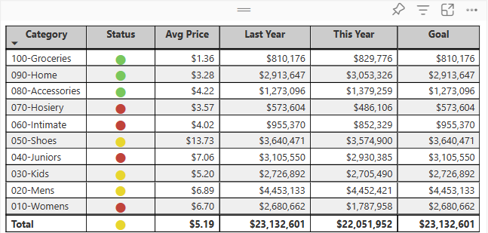

Tables
A Table display data in rows & columns.
Each column represents a field & each row represents a record.
Ideal for showing exact values.
Use Cases:
Display detailed data.
Show exact values for reporting.
Support data validation & auditing.
Provide structured view of datasets.
Best for reports requiring precision, data inspection.

Slide 42
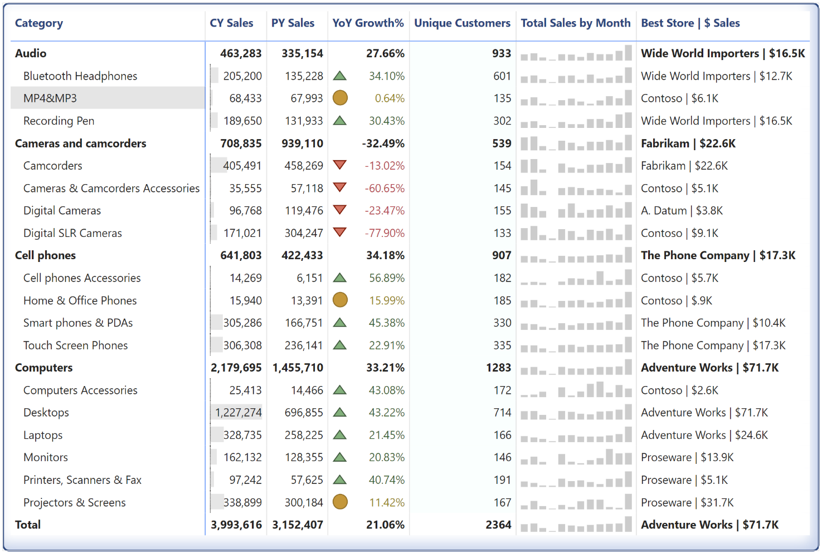
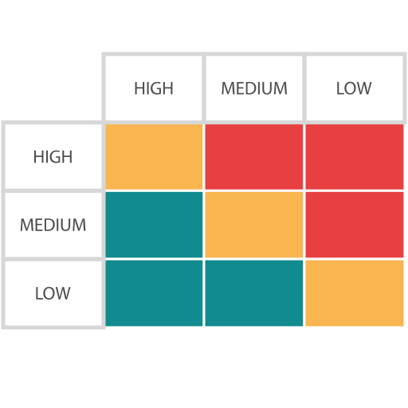
Matrix
A Matrix display data in a grid format.
Enables dynamic data aggregation.
Data is grouped into rows & columns.
Values are summarized (sum, average, count, etc.…).
Users can drill down into details.
Use Cases:
Compare multiple dimensions of data.
Perform cross-tab analysis.
Display hierarchical relationships.
Best for financial reports, sales analysis, multi-level data comparison.

Slide 43
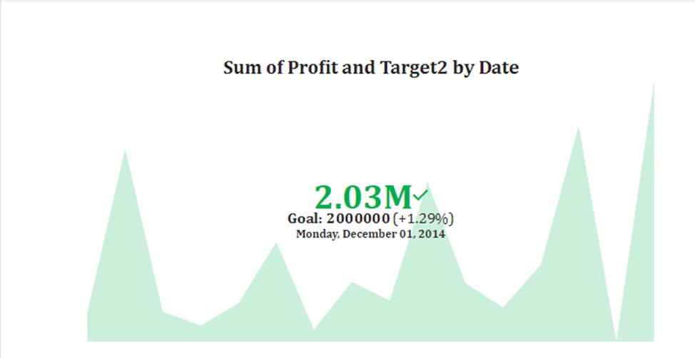

KPI Charts
KPI Charts are visuals that shows:
Actual value
Target (goal)
Trend over time
KPI = Key Performance Indicator
KPI charts help track performance over time.
Compare actual values against targets.
Use Cases:
Monitor business performance.
Track progress toward goals.
Identify underperformance.
Best for executive dashboards, performance monitoring

Slide 44
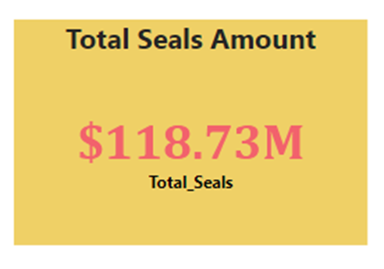

Cards
Card visuals display single key values.
Used to highlight import metrics (KPIs).
Common in dashboards in quick insights.
Use Cases:
Display KPIs.
Highlight important numbers.
Provide quick summary of data.
Best for dashboards, executive reports.

Slide 45
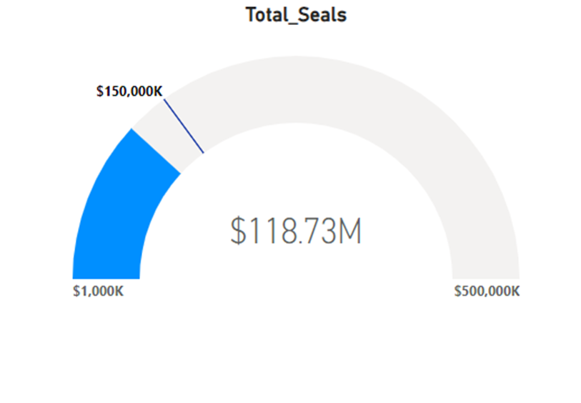
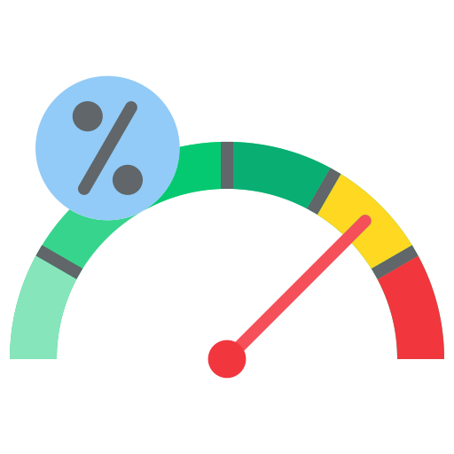
Gauge Charts
Gauge Charts are a circular visual that shows current value, target value, minimum & maximum range.
It displays performance against a goal.
Designed like a speedometer (car dashboard).
Show how close a value is to a target.
Use Cases:
Monitor progress toward goals.
Display KPIs visually.
Show performance status.
Best for dashboards, executive summaries.

Slide 46
Filters
Filters are used to limit the data displayed in a report.
Helps focus on specific information.
Works behind the scenes or visibly.
Applies to visuals, pages, or entire reports.
A filter in Power BI works behind the scenes. It is not part of the visual layer unless you make it visible via the filter pane.
Filters help control what data is shown.
Essential for data analysis and reporting.
Best when combined with slicers.

Slide 47
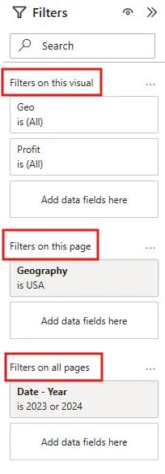
Types of Filters in Power BI
Visual-Level Filters
Page-Level Filters
Report-Level Filters
Drillthrough Filter
Filter Types

Slide 48
…
Visual-Level Filters | Page-Level Filters | Report-Level Filters | Drillthrough Filters
Applied to one specific visual | Applied to all visuals on a page | Applied to entire report | Used for detailed analysis
Does not affect other visuals | Useful for page-specific analysis | Affects all pages and visuals | Navigate from summary to detailed pages
Example: Show only Top 5 products in a chart | Example: Filter a page by Region = Africa | Example: Show only Year = 2025 | Example: Click a customer → view detailed transactions

Slide 49
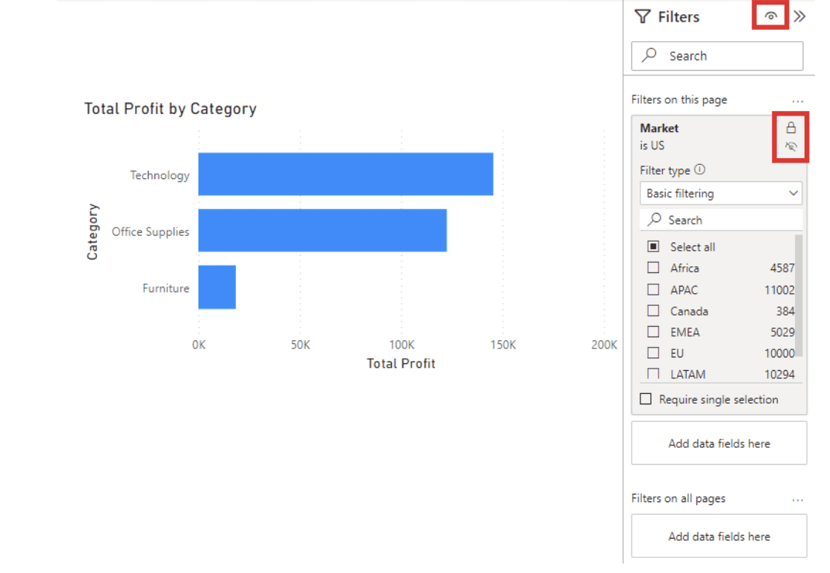
Filter Types (Advanced)
Basic Filtering (Checkbox selection)
Advanced Filtering (Conditions like >, <, contains)
Top N Filtering
Relative Data Filtering

Slide 50
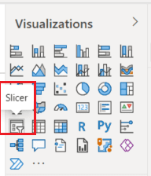
Slicers
Slicers are visual filters in Power BI.
Allows users to filter data interactively.
Works directly on report visuals.
Provides an easy way to segment data.
They enable viewers to focus on specific subsets of data, making reports more dynamic and user-friendly.

Slide 51
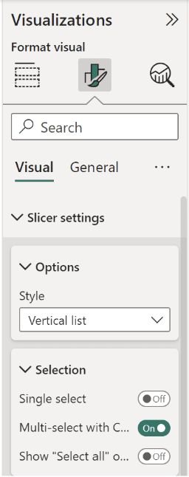
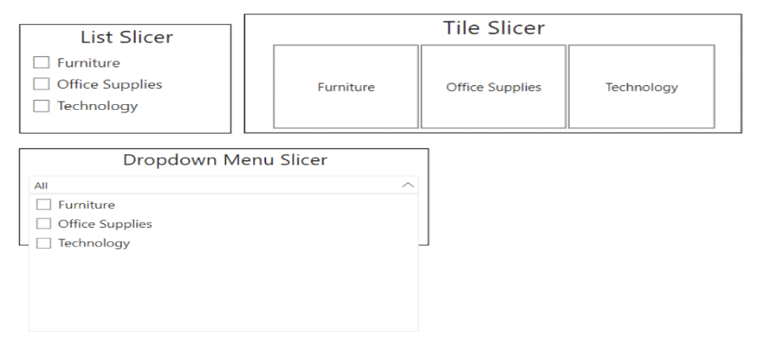
Types of Slicers in Power BI
List Slicer – Displays values in a list.
Dropdown Slicer – Saves space with dropdown.
Between Slicer – For ranges (numbers/dates)
Relative Date Slicer – Filters based on time (last 7 days, months, etc.).
Hierarchy Slicer – For structured data (Year → Month → Day)

Slide 52
Slicer Vs Filter Pane
Slicer | Filter Pane
Visible on report | Hidden Panel
User-friendly (More interactive) | More advanced
Interactive | Static filtering
Best for dashboards | Best for developers
Takes space on canvas | Less space usage

Slide 53
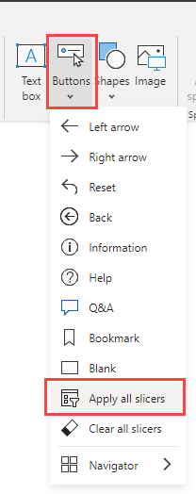
Buttons
Buttons are Clickable elements used for navigation and actions.
Help users interact with reports easily.
Can trigger:
Page navigation
Bookmark actions
Drillthrough

Slide 54






Types of Data Sources
Files
Excel
CSV
JSON
Databases
SQL Server
MySQL
Oracle
Online Sources
Web pages
APIs
Cloud Services
SharePoint
Google Analytics
👉🏿 To get all the data sources

Slide 55

Connecting to Data
Open Power BI Desktop
Click Get Data
Choose a data source
Connect using credentials (if needed)
Load or Transform data
Build your data model
👉🏿 Two options:
Load (directly use data)
Transform Data (clean before use)

Slide 56
Import Mode Vs Direct Query
Feature | Import Mode | DirectQuery Mode
Performance | ⚡Very fast | 🗄️Depends on data source
Supports Full DAX & Modeling | ✅ Yes | ❌ Limited
Offline Access | ✅ Yes | ❌ No
Auto-Refresh | ❌ No (must schedule it) | ✅ Yes (always live)

Slide 57


Publishing Power BI Reports
Microsoft Power BI provides a seamless workflow for creating and sharing interactive reports and dashboards.
After designing a report using Power BI Desktop, you can publish it to Power BI Online to share it with your team or a wider audience.
In Power BI Desktop, click on the “Publish” button in the Home tab of the ribbon.

Slide 58




… Steps
In Power BI Desktop, choose File > Publish > Publish to Power BI or select Publish on the Home ribbon.
Sign in to Power BI if you aren’t already signed in.
Select the destination. You can search your list of available workspaces to find the workspace into which you want to publish. The search box lets you filter your workspaces. Select the workspace, and then click the Select button to publish.
When publishing is complete, you receive a link to your report. Select the link to open the report in your Power BI site.

Slide 59
Sharing Methods
🚀Sharing Method | ✅Pros | ❌Cons
📒 .pbix file | No account needed | Must have Power BI Desktop
🌩️ Power BI service | Easy online sharing | Requires Power BI account

Slide 60

Power BI Workspace
Power BI Workspace refers to a collaboration hub where you and your team can collaborate to create interactive dashboards and reports.
To share your content with others in Power BI, you can begin by creating what is essentially another designated area, referred to as a Workspaces.
These workspaces are alternatively known as “App workspaces” or “Organizational workspaces”.
Workspaces are most effectively utilized as collaborative spaces where teams can efficiently share and collaborate on content.

Slide 61


Dashboard & Reports
A Power BI dashboard is a single page view that brings together selected visuals from one or more reports. It is useful for combining information from different reports or subject areas into one place, making it easy to monitor key metrics at a glance.
A Power BI report is an interactive document that can contain or multiple pages and may use one or several data sources. Reports are designed for detailed analysis.

Slide 62
Dashboard Vs Reports
Dashboard | Report
Visual and interactive | Detailed and structured
Real-time or live data | Historical data
Quick overview | In-depth analysis
Charts and KPIs | Tables and text
Used by managers | Used by analysts/admins

